Slide 1
Investments, convergence
and
capital inflows in Central Eastern Europe
Fabrizio Coricelli
Paris School of Economics and CEPR
National Bank of Poland Annual Conference, Warsaw October 20, 2023

Slide 2
Convergence in Incomes per capita of CEE
Growth rates over 1995-2023
Clear absolute convergence
Convergence rate: 2.6% per year
Convergence not only vs Germany but also among CEE
Germany

Slide 3
Investments and convergence
What is the role of investment in capital in the convergence process?
What is the role of foreign capital?

Slide 4
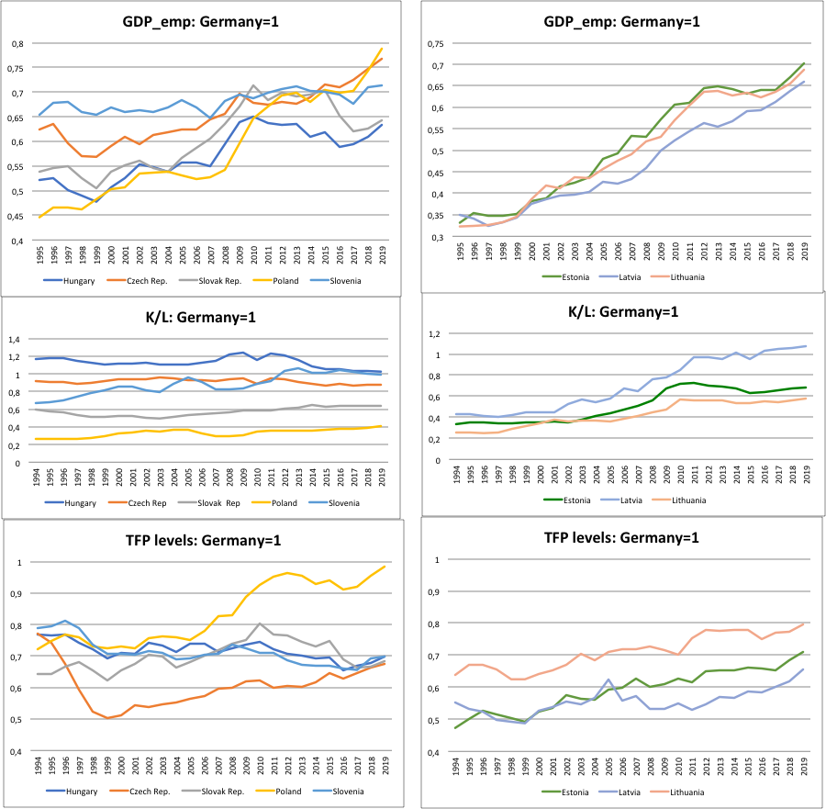
GDP per worker, capital and tfp

Slide 5
Heterogeneous picture
Two groups
First:
- High K/L but low TFP levels (rel. to Germany): Czech Rep., Hungary, Slovenia and Latvia
- Further convergence requires technological change (TFP growth)

Slide 6
Second group
Low K/L ratio:
- Poland, Slovak Rep., Estonia and Lithuania
- Further convergence passes through investment growth
TFP:
- Poland the exception, with TFP at the same level as Germany
- The others have still a significant gap to fill relative to Germany

Slide 7
Dynamics
Worrying signals from the dynamics
K/L: since 1995, Poland, Slovenia, and the Baltics show raising capital-labor ratios, flat for the others
Similar for TFP: Poland and the Baltics on a increasing trend, while the others show no improvements

Slide 8
Role of foreign financing
Up to the global financial crisis large net inflows of foreign capital supported investments
Large gap between savings and investments, except for Slovenia
After the GFC the gap sharply narrowed

Slide 9
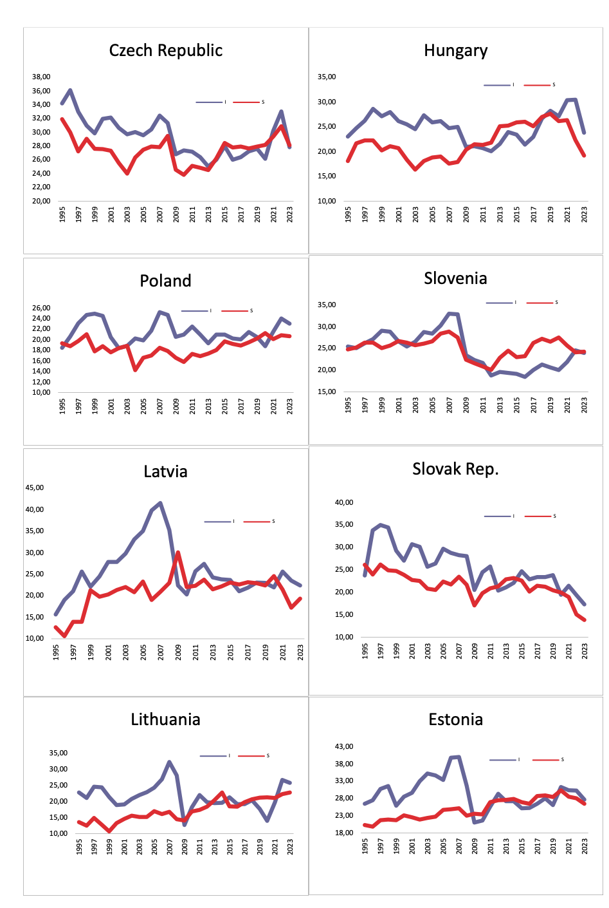
Savings and Investments in CEE

Slide 10
Inefficiencies
In a context of reduced capital inflows
Domestic savings would need to increase sharply now
Inefficient, given that still large gaps in GDPpc exist and thus convergence calls for high income in the future

Slide 11
Looking forward: External constraint becomes stricter
Potential bad news for CEE
Green transition calls fore large investments also in core EU countries
Reducing the potential inflows for CEE
Plus, huge need for infrastructural investments in Germany beyond the green transition
EU enlargement can redirect EU funds from CEE to new members

