Slide 1
What is special about investment in Central Europe?
NBP CoFEE conference Warsaw, 20 October 2023
Mario Holzner
holzner@wiiw.ac.at
@MarioHolzner

Slide 2
Investment shares in Central Europe are as diverse as in the EU in general
Gross Fixed Capital Formation, in % of GDP, average over 2015-2022
Note: Averages over the period of 2015-2022 are subject to data availability and might represent shorter time periods in some cases. Source: Eurostat, own calculations.

Slide 3
Membership in the EU does not seem to make a huge difference…
Gross Fixed Capital Formation, in % of GDP, average over 2015-2022
Source: wiiw Annual Database, national statistical offices, own calculations.

Slide 4
… but somewhat higher shares in private services investment
Gross Fixed Capital Formation, by NACE categories, in % of total, 2015-2022
Note: Averages over the period of 2015-2022 are subject to data availability and might represent shorter time periods in some cases. The groupings reflect NACE categories AB, CDEF, GHIJKLMN, OPQRS. The ranking is related to the overall investment share in % of GDP, with higher values on the left side. Source: wiiw Annual Database, national statistical offices, own calculations.

Slide 5
… not necessarily driven by differences in FDI intensity
FDI inflows, in % of GFCF, average over 2015-2022
Note: The ranking is related to the overall investment share in % of GDP, with higher values on the left side. Source: wiiw Annual Database, national statistical offices, own calculations.

Slide 6
… implying less machinery investment but more dwellings
Gross Fixed Capital Formation, by type, in % of total, 2015-2022
Note: Averages over the period of 2015-2022 are subject to data availability and might represent shorter time periods in some cases. The groupings reflect type 11, 12 & 4, 2w, 5. The ranking is related to the overall investment share in % of GDP, with higher values on the left side. Source: wiiw Annual Database, national statistical offices, own calculations.

Slide 7
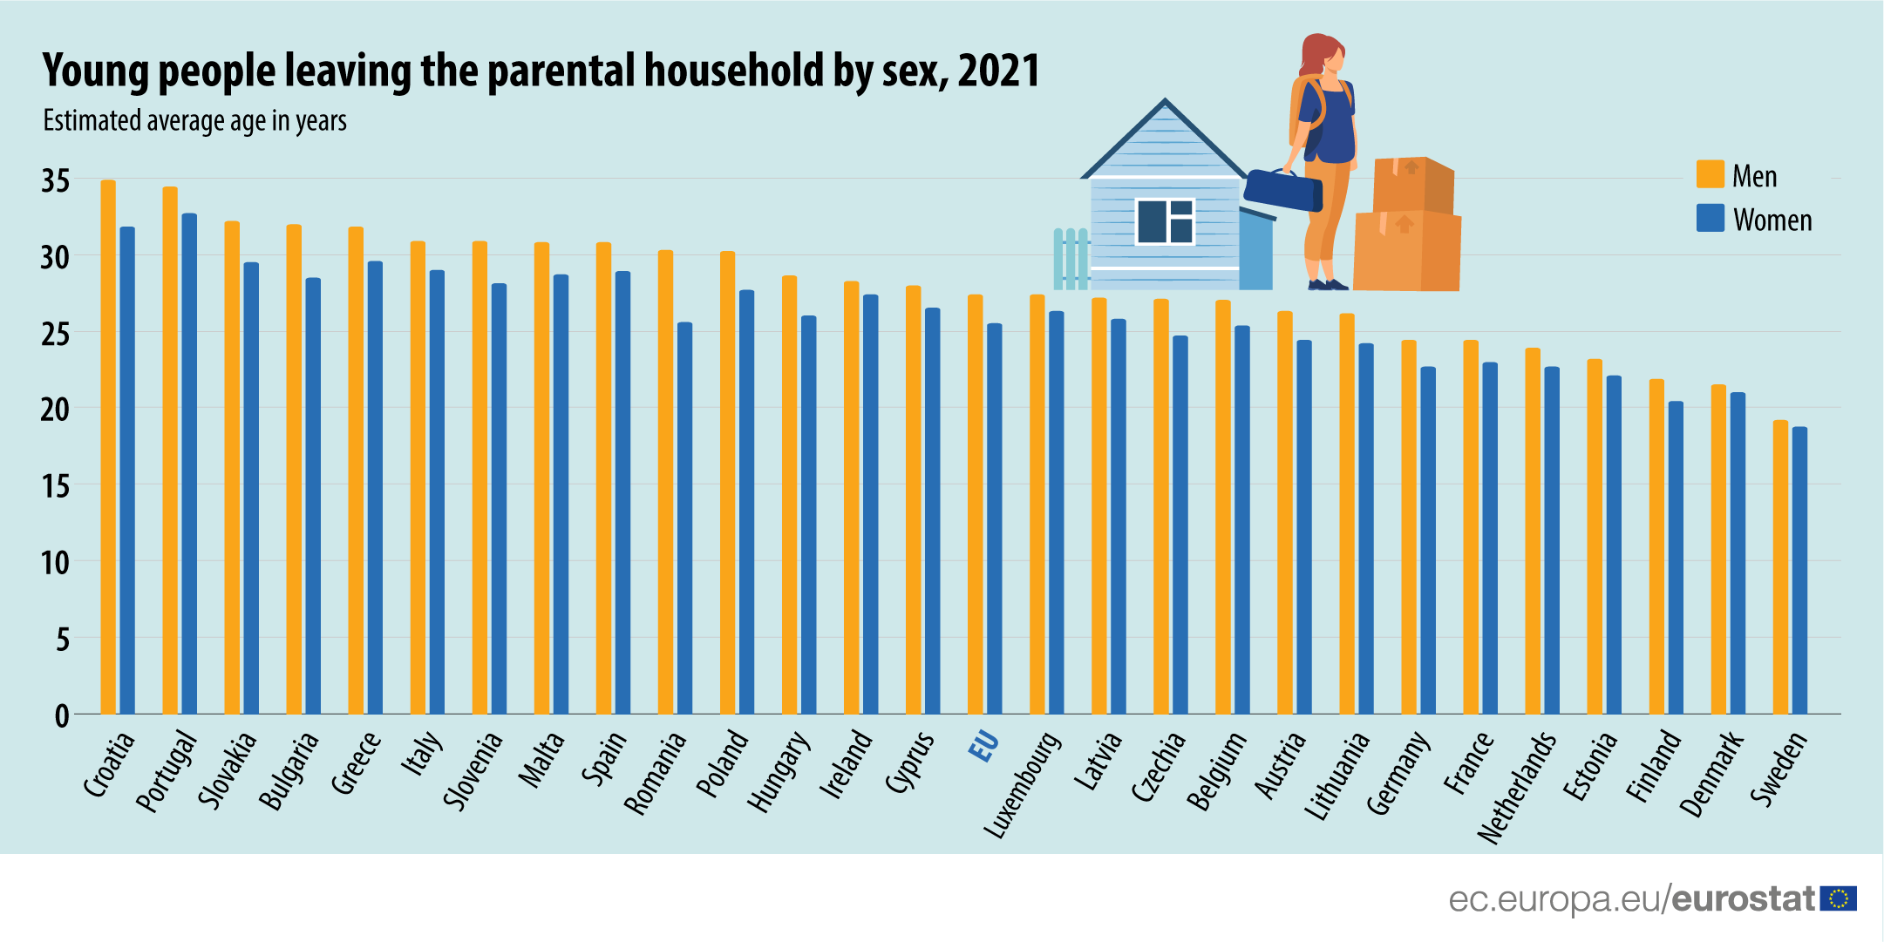
How to attract young families and accumulate human capital necessary for the digital revolution?
UN population projections, % change between 2015 and 2045

Slide 8
Conclusions
Diverse levels of investment shares in Central Europe
EU membership does not seem to make a difference
More overall investment comes with higher shares in (private) services investment
This development is not driven by FDI inflows – domestic factors important
Consequently, higher investment shares correlate with less investment in machinery but more investment in dwellings
Providing (public) housing for young families is not only an issue of social security but related to human capital accumulation for the digital revolution

Slide 9
Thank you for your attention!
Follow us:
www.wiiw.ac.at

