Slide 1
Investment for Growth
11th NBP Annual Flagship Conference
on the Future of the European Economy (CoFEE)
Session II. European and national policies to stimulate growth/investment
Warsaw, 20 October 2023
Birgit Niessner,
Oesterreichische Nationalbank
Economics Department
www.oenb.at

Slide 2
Pace of convergence in CESEE has remained relatively robust, even after 2008

Slide 3
Average value-added growth has gone down in all CESEE

Slide 4
Average value-added growth has gone down in all CESEE

Slide 5
Investment in CESEE has recovered well since 2008

Slide 7
CESEE have gone a long way already towards decarbonization…

Slide 8
…Yet CESEE economies are still rather carbon- and energy-intense

Slide 9
Several CESEE managed to decouple if taking the 1990s into consideration

Slide 10
Picture much less optimistic after the low-hanging transformation fruits

Slide 11
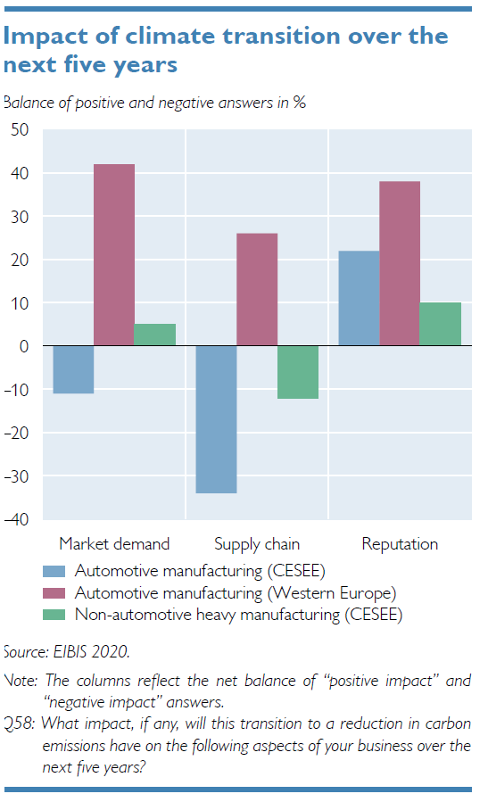
(In many CESEE) Essential automotive sector concerned about the green transition

Slide 12
Just one of many faces of the lack of skilled labor…

Slide 13
…which will likely worsen in light of the gloomy demographic trends

