Slide 1
Session I. Factors shaping growth in Europe – a stocktaking
Magdolna Sass
Director (Institute of World Economics, Centre for Economic and Regional Studies)
11th NBP Annual Flagship Conference on the Future of the European Economy (CoFEE)
20 October 2023, Warsaw

Slide 2
Further factor
To be added to the factors mentioned plus to raise further questions for analysis
World economy context and impact: new (?) trends
A short note on the Visegrad countries

Slide 3
Growth prospects/changes in the world economy
World economy/politics changes (emerging economies, rivalry, multipolarity etc.)
Economic problems (country and firm level, overcapacities, productivity growth problems etc.)
Non-economic problems with economic impact (COVID, Russia’s invasion in Ukraine)
Increased government intervention everywhere – including in the EU/member countries
Historically already since the 2008-9 crisis, with various renewals

Slide 4
The Europan Union was hostile for a long period of time towards industrial policy (e.g. competition rules, state aid rules etc.) –substantial changes in this stance
To handle/manage the multiple challenges: increased use of industrial policy tools with multiple aims (green transition, sustainability, digitalisation, resilience of supply chains, promotion of innovation, competition from China, Russia’ invasion in Ukraine – related energy problems due to dependence on Russian oil/gas, challenges from industrial policies of other countries) plus to revive the European „model”
Both at the EU-level and at member country level

Slide 5
General government, Economic affairs, % of GDP
Source: Eurostat
Notes:
Ireland 2010, Greece and Slovenia, 2013

Slide 6
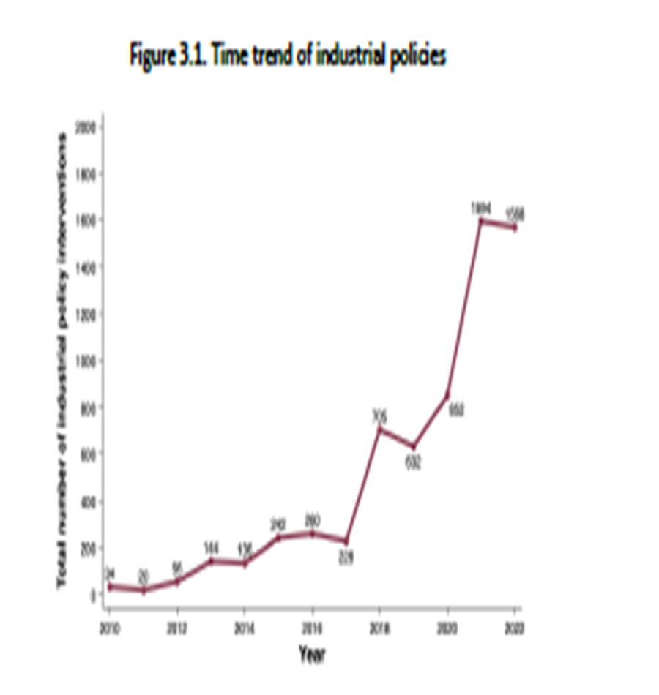
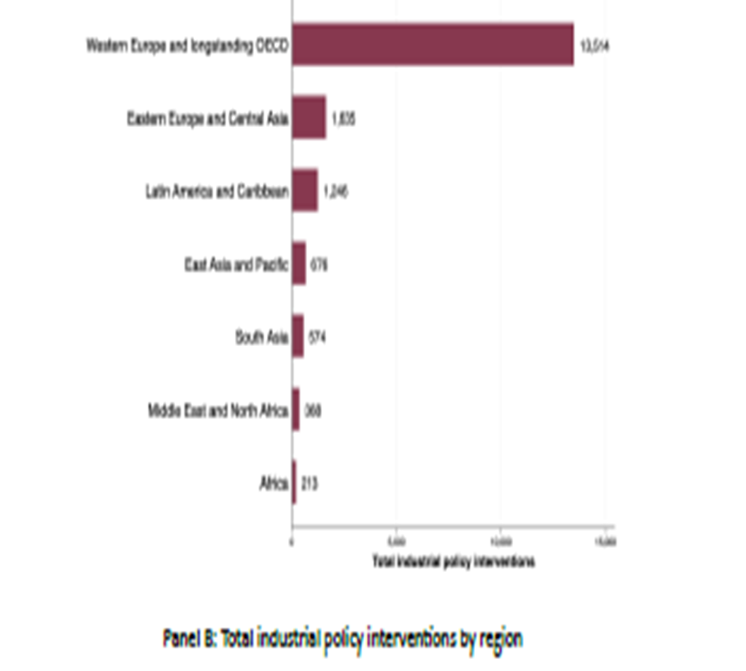
Source: Juhász et al., NBER, 2023

Slide 7
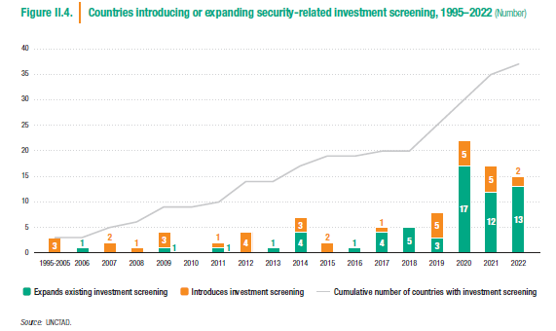
FDI policy changes: increased competition for FDI, at the same time, more restrictions (FDI screening)
Source: UNCTAD

Slide 8
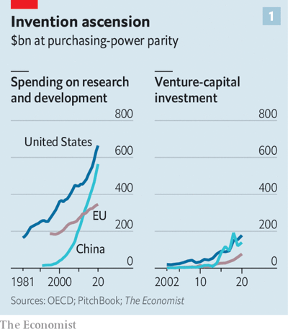
Important area: investment in innovation
Quick growth, governments heavily involved, especially in China
Though productivity impact ambiguous (low efficiency, misallocation of funds, SOEs in China, but also technology leadership in certain areas)
USA: programs with industrial policy and technology components, Infrastructure Investment and Jobs Act, the Chips and Science Act, the Inflation Reduction Act
What about Europe/EU?

Slide 9
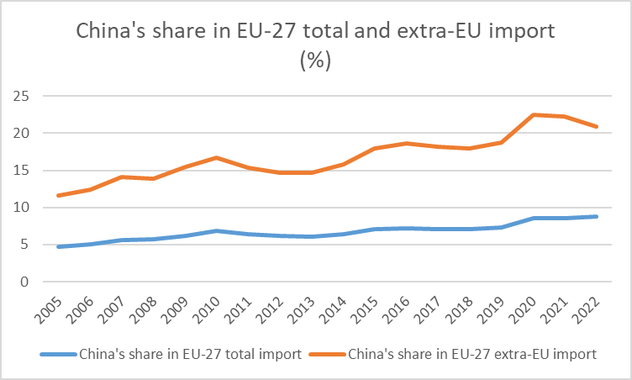
China
Enhanced state intervention and generous and sustained state subsidies, distorting world trade because of country size (Mavroidis - Sapir, 2021)
EU: increasingly asymmetric dependence on inputs from China (Garcia Herrero, 2019) our research: on Chinese (owned) inputs
Previous industry cases: solar panels, e-batteries: state subsidy – large investments – low prices – forcing producers from other countries (incl. EU) out of business
Now: e-vehicles: NYT 5 Oct 2023: „China’s E.V. Threat: A Carmaker that Loses $35,000 a Car”
Source: EUROSTAT

Slide 10
„New” era of industrial policy and state intervention (e.g. Alami, 2023)?
„State subsidy competition” – race to the bottom/top?
„Domino-effect”? (impact of industrial policies of big economies (esp. USA, China) on others – „be there or be square”)
Overall: increased protectionism, decoupling, slowing down of globalisation or even deglobalisation?

Slide 11
Problems with industrial policy/policies
Multiple aims: collusions
Textbook problems with industrial policies: large (potential) efficiency losses (rent-seeking, corruption, infant industries forever infant, increased red tape…)
Means needed – differ at the country level, depending on the level of development, on fiscal prudence, indebtedness etc. – different manoeuvring rooms may increase geopolitical tensions
Partly connected to industrial policy: increase in protectionism
Special problem EU: difference in the depth of pockets of member states plus may hurt policies previously elevated to the EU-level
(However, (limited) means and quest for success also push industrial policies to be more efficient… - new types, new structures, new modus operandi possible)
Notes:
az iparpolitika és a monetáris politika egymást támogató célokat is közösíthet. Az iparpolitika hosszú távú stratégiákkal és célkitűzésekkel operál, amelyek célja a gazdasági szerkezet átalakítása, az innováció és a termelékenység növelése. A monetáris politika rugalmasabb és rövid távú célkitűzéseket követ, mint például a gazdasági növekedés támogatása vagy az árstabilitás biztosítása. Ennek eredményeként a monetáris politika által biztosított stabilitás és a hosszú távú industripolitikai stratégiák támogatása eredményesen kiegészítheti egymást.

Slide 12
Consequences for investments and monetary policy
Many question marks
Investments may increase in the medium run (reshoring, backshoring, friendshoring – takes time – sunk costs)
Means needed for industrial policy – to avoid fiscal problems, restructuring of state finances required, possible collusions with monetary policy (access to finance/credits; price stability) and certain state capacities may be hurt
Due to increased protectionism, the low inflation enjoyed in the last two decades can be over, intense competition and international sourcing/offshoring kept price increases down
Increased „friendtrading” and domestic markets shielded from competition may result in trade diversion and higher prices (of goods and workers) – inflationary pressures may increase

Slide 13
A very short note and question marks on Visegrad countries
Catching up goin on
FDI-dependent (Nölke-Vliegenthart, 2009) or rather GVC-based development paths (Poland less, other three more) as FDI is connected to GVCs – important role in maintaining the competitiveness of EU/German companies
Special problems of GVC-relatedness (structural weakness plus few lead firms), problems of upgrading, low productivity growth, plus ageing population, labour outflow, fiscal capacity, labour shortage (?), skills – tight labour market
Slowdown of FDI (problems with the German economy – slowdown of German FDI) backshoring may compensate (?) – while this is the main engine of growth and of GVC-integration with an upgrading potential
Industrial policy: more exposed countries with less means (esp. Poland and Hungary – EU) though more and more active (exc. for Slovakia?)
Besides the similarities, increasing heterogeneity

Slide 14
Catching up: Visegrad do quite well (2010-2022)
Source: Zsibók, 2023

Slide 15
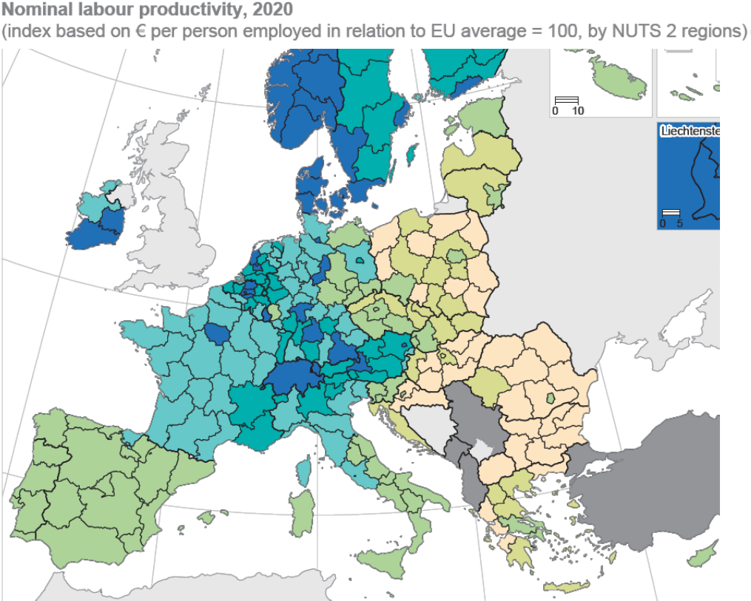
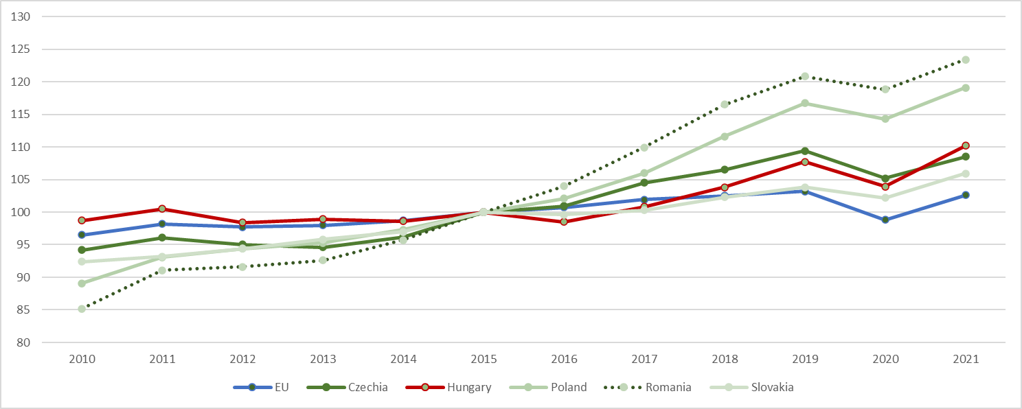
Labour productivity
Nominal labour productivity at the regional level: large and persistent East-West divide and regional differences
Real labour productivity: differences

Slide 16
Foreign value added content of gross exports (2020)
Source: OECD TiVA

Slide 17
General government, Economic affairs, % of GDP

Slide 18
Magdolna Sass
sass.magdolna@krtk.hu

